Slide 1


Unit 1: Lesson 4 Generation Z

Slide 2
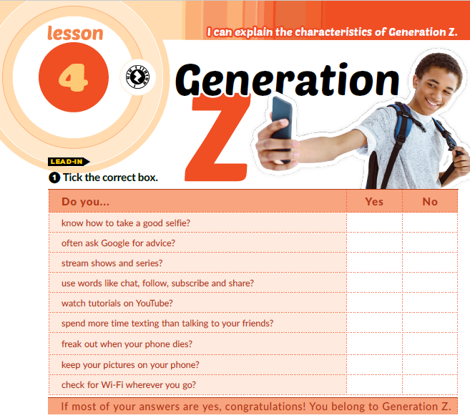

Slide 3
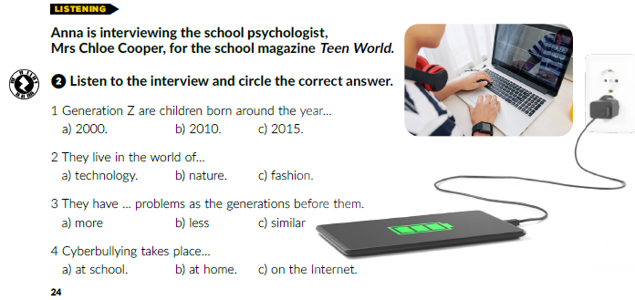
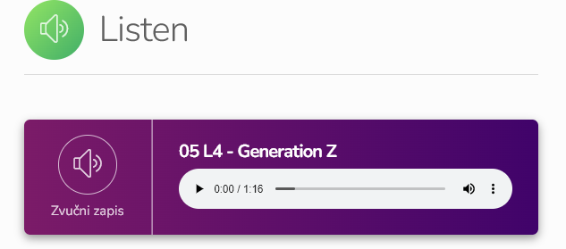
https://www.e-sfera.hr/dodatni-digitalni-sadrzaji/d314ae2c-8f82-4589-a380-0c07cbce5c1c/

Slide 4
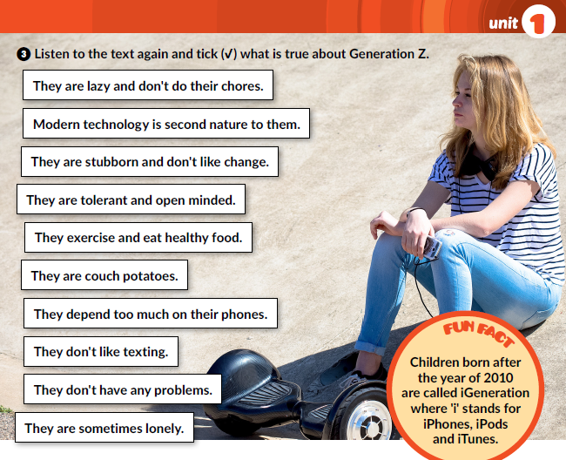
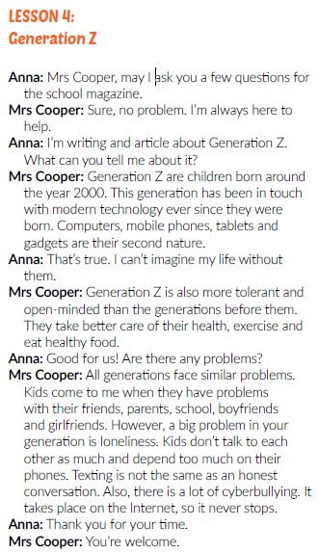

https://www.e-sfera.hr/dodatni-digitalni-sadrzaji/d314ae2c-8f82-4589-a380-0c07cbce5c1c/

Slide 5
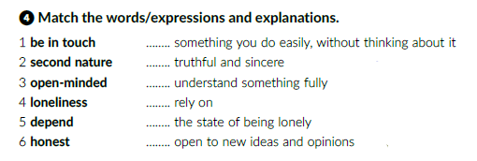
2
6
1
5
4
3

Slide 6
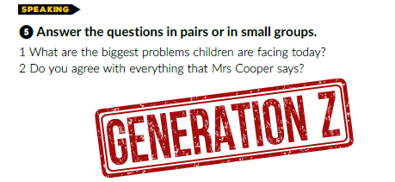

Slide 7
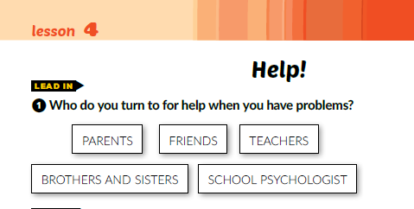

Slide 8
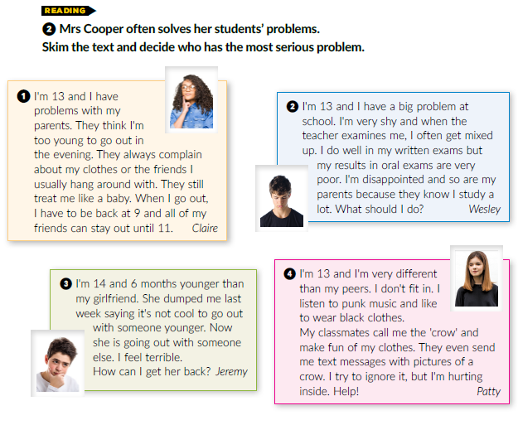

Slide 9
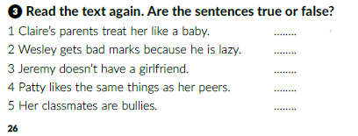
T
F
T
F
T

Slide 10

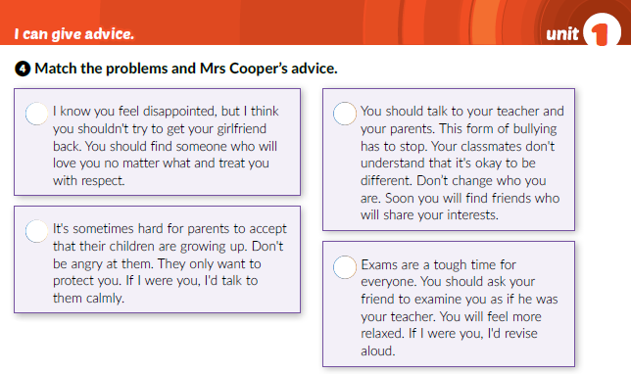
3
4
1
3

Slide 11
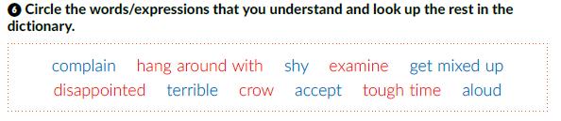

Slide 12
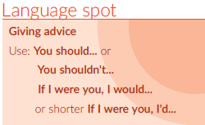
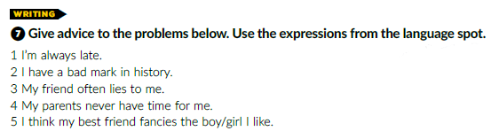

You should leave home earlier.
If I were you, I would study more and sometimes watch History Channel.
You should’t take him / her serioulsy all the time.
If I were you, I’d ask them to spend more time with me.
If I were you, I’d ask them if that is true.

Slide 13
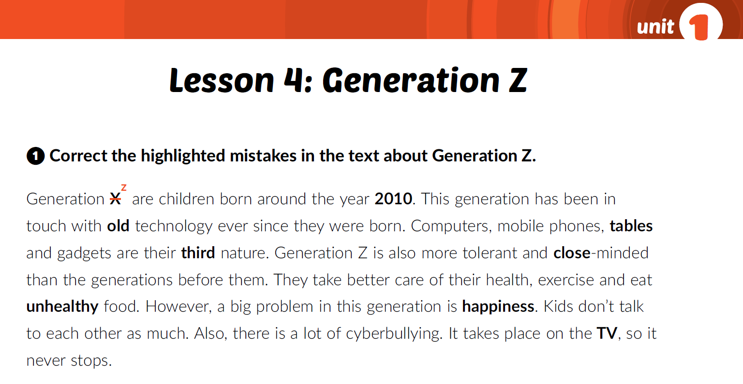
Open your workbook on page 15.
2000
x
new
x
tablets
x
second
x
open
x
healthy
x
loneliness
x
Internet
x

Slide 14
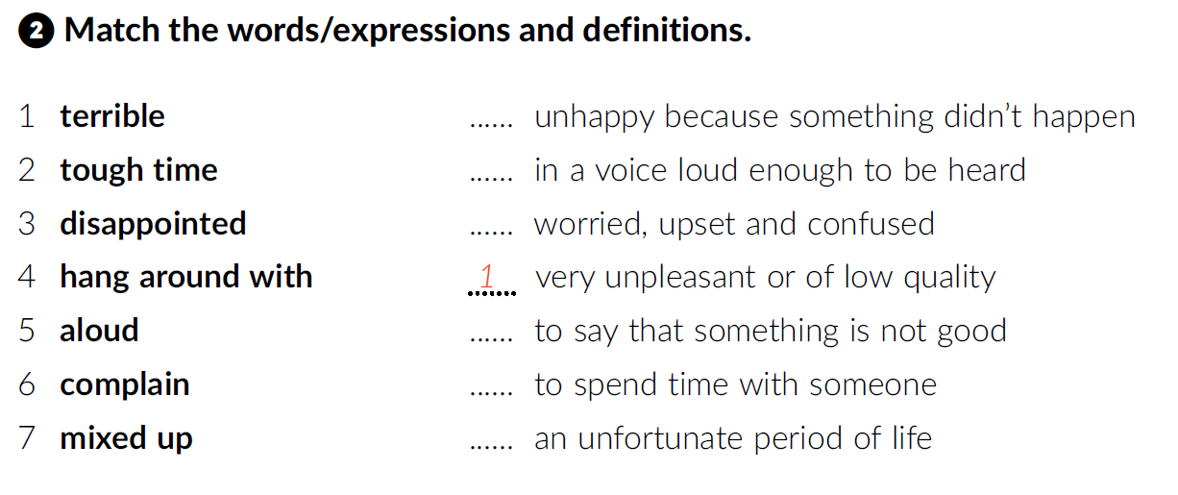
3
5
7
6
4
2

Slide 15
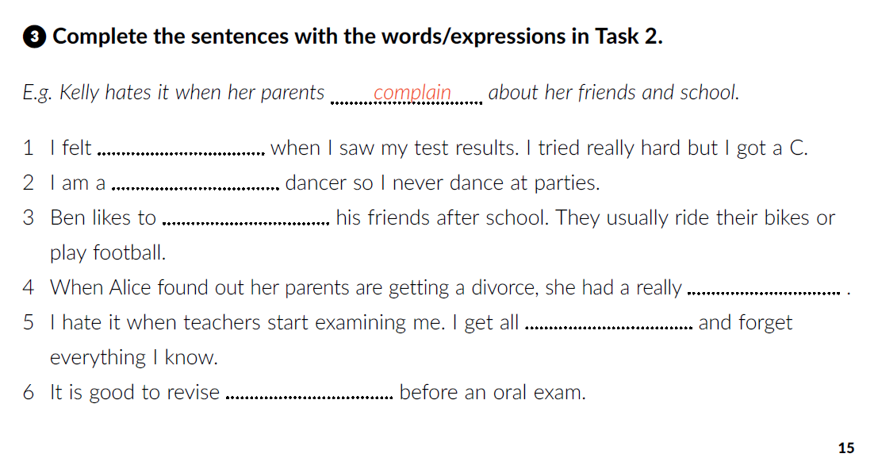
disappointed
terrible
hang around with
tough time
mixed up
aloud

Slide 16
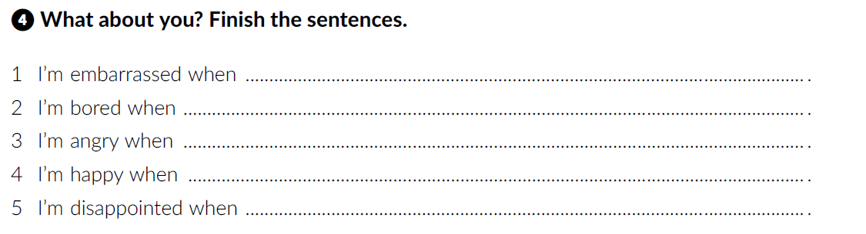
I have to speak before the class.
I have nothing to do.
someone lies to me.
I am with my friends.
I study hard and fail the exam.

Slide 17
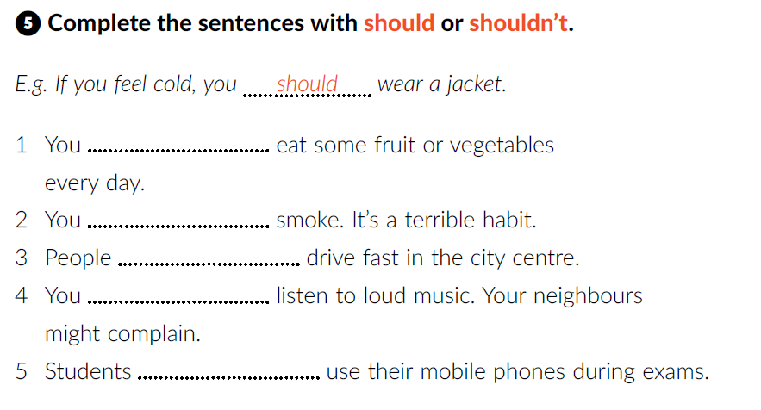
should
shouldn’t
shouldn’t
shouldn’t
shouldn’t

Slide 18
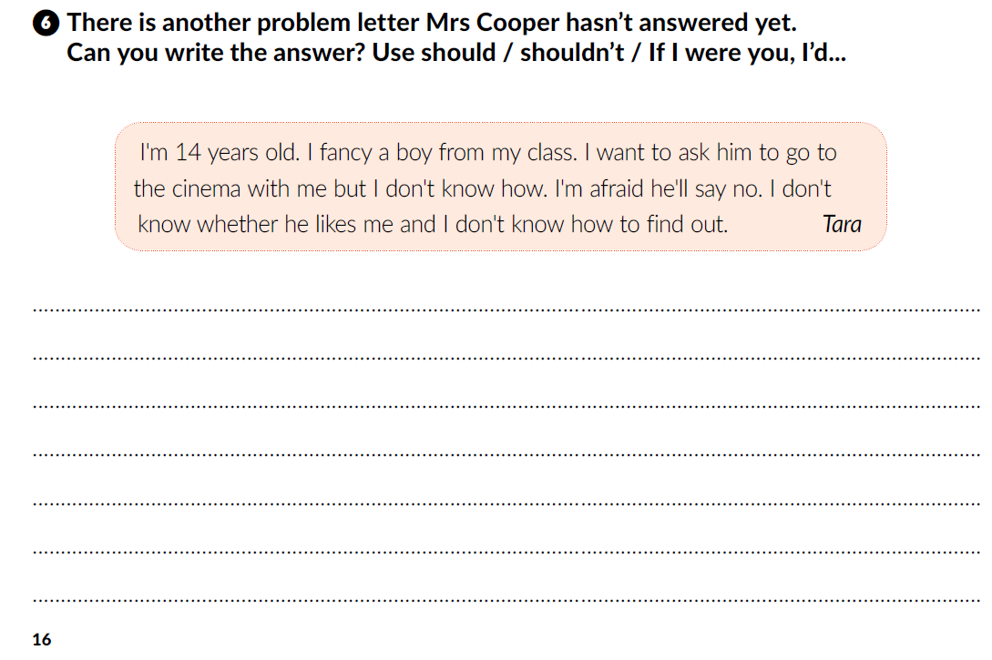

Slide 19
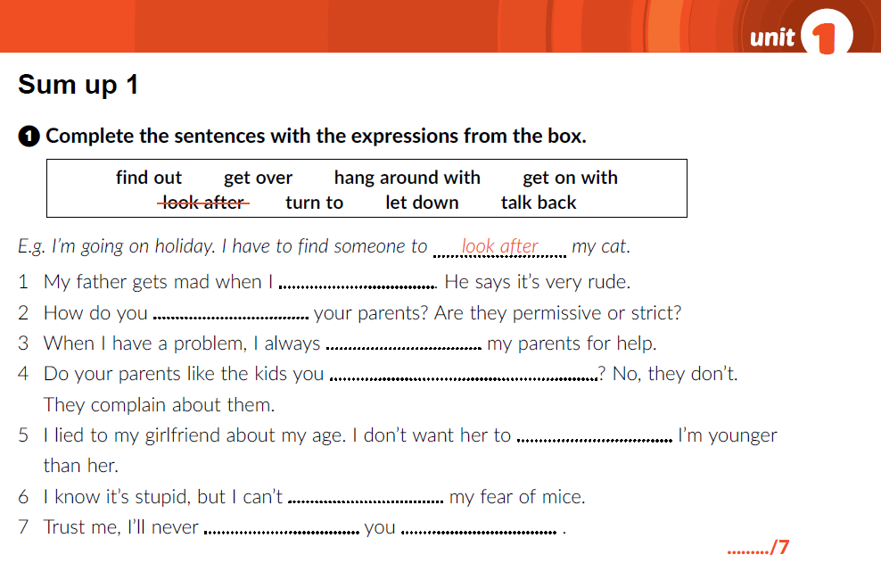
talk back
get on with
turn to
hang around with
find out
get over
let
down

Slide 20
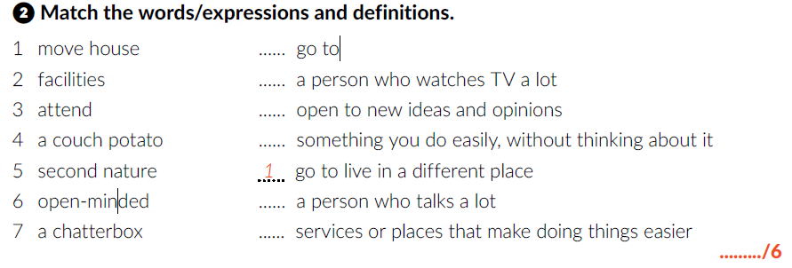
3
4
6
5
7
2

Slide 21
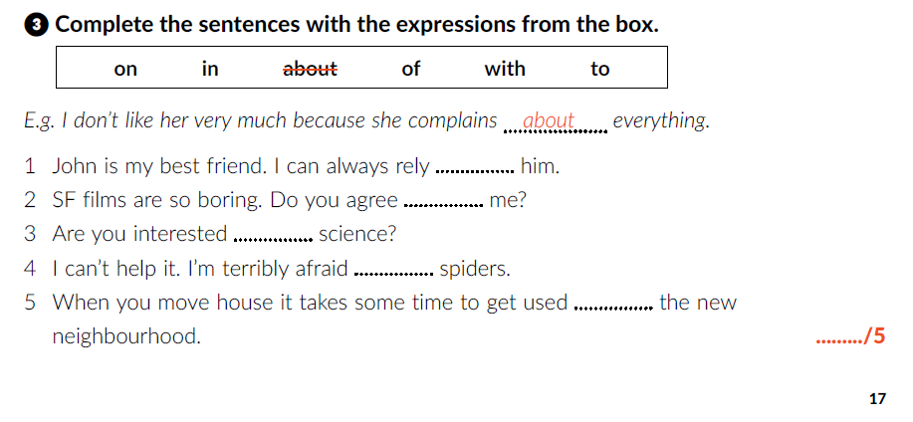
on
with
in
of
to

Slide 22
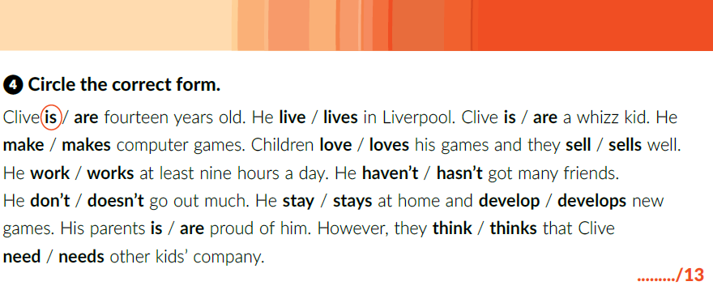

Slide 23
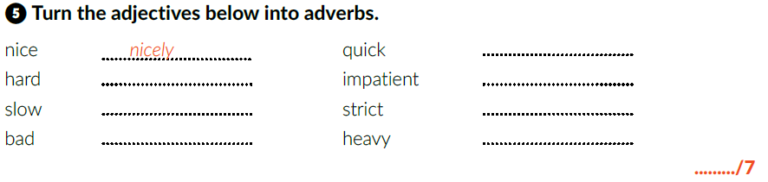
quickly
hard
impatiently
slowly
strictly
badly
heavily

Slide 24
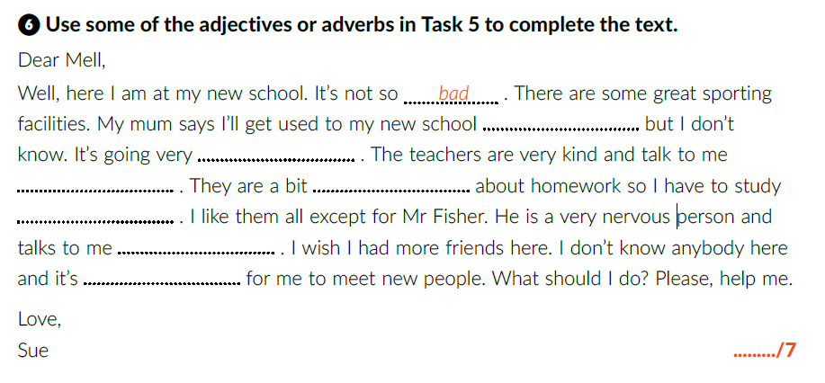
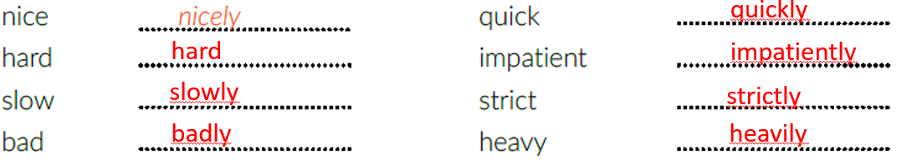
quickly
slowly
nicely
strict
hard
impatiently
hard

Slide 25
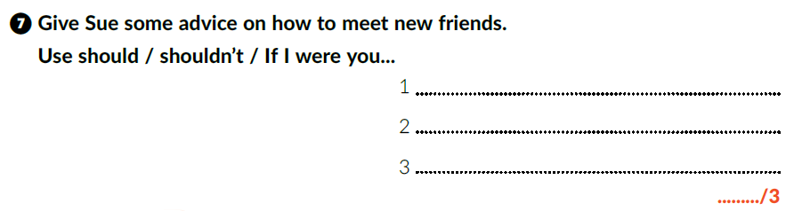
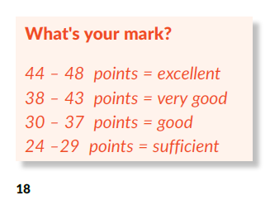
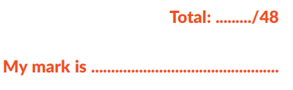
You shouldn’t stay at home all the time.
You should learn how to start a conversation.
If I were you, I’d go to dancing classes.

Slide 26
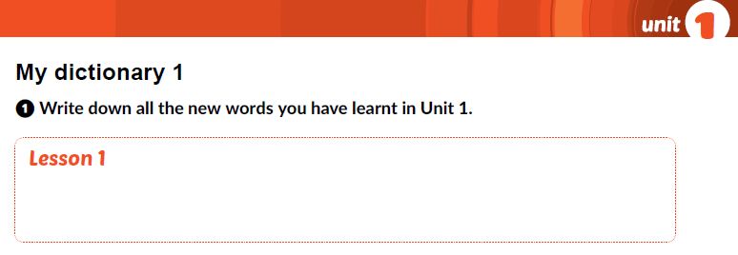
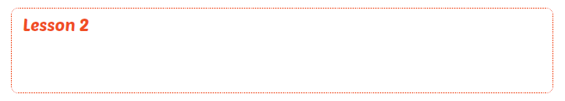
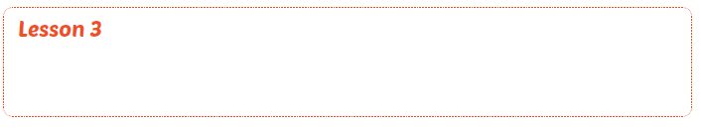
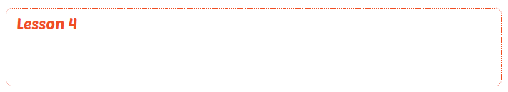
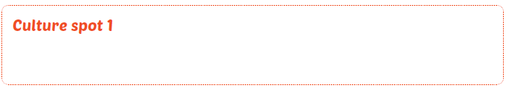

Slide 27
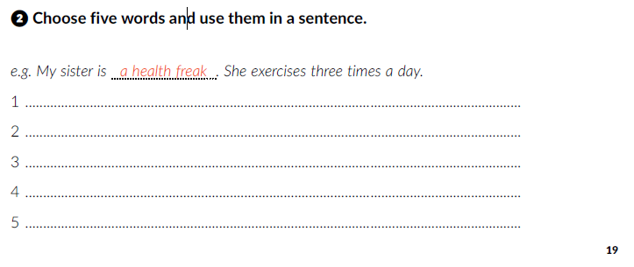

Slide 28

PLAY AND LEARN
https://www.e-sfera.hr/dodatni-digitalni-sadrzaji/d314ae2c-8f82-4589-a380-0c07cbce5c1c/

